Slide 1
4 TOOLS FOR
21ST CENTURY EDUCATION
Ken Kay
Notes:
Make intro slide with logo and title

Slide 2
TOOL #1
STUDENT A VS STUDENT B

Slide 3
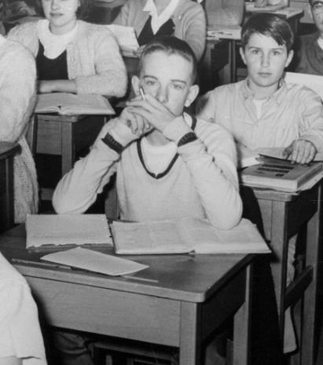
STUDENT A
STUDENT B
SELF-DIRECTED LEARNER
COMPLEX THINKER
EFFECTIVE COMMUNICATOR
COMMUNITY CONTRIBUTOR
QUALITY PRODUCER
EFFECTIVE & ETHICAL USER OF TECHNOLOGY
CREATOR AND INNOVATOR
MATH SCIENCE ENGLISH SOCIAL STUDIES

Slide 4
TOOL #2
CREATIVITY RUBRIC

Slide 5
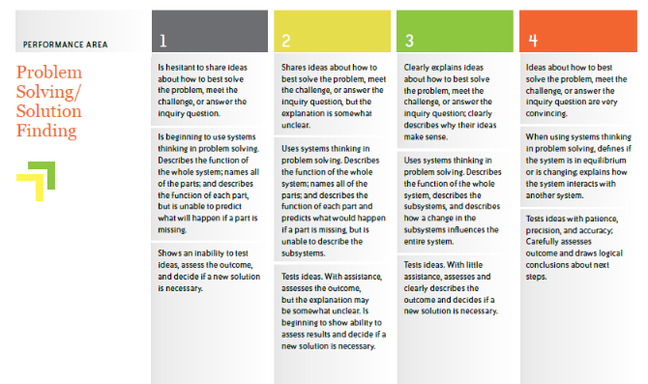
TOOL #3
PERFORMANCE TASK ACTIVITY

Slide 6
TOOL #4
STEP21 ASSESSMENT

Slide 7
CONTACT ME
@kenkay21
kkay@edleader21.com
www.edleader21.com

