Slide 1
PREPARING HAWAII’S STUDENTS FOR THEIR 21ST CENTURY LIVES
Ken Kay
Notes:
Make intro slide with logo and title

Slide 2
A CRITICAL MOMENT IN K-12 EDUCATION

Slide 3
Accountability
Transformation

Slide 4
STUDENT A

Slide 5
STUDENT B

Slide 6
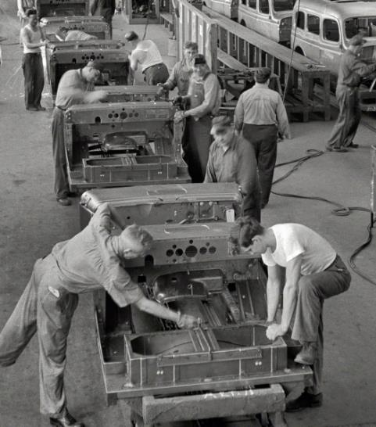
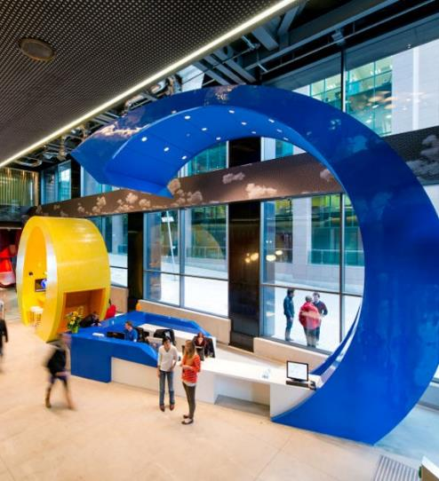
STUDENT A
STUDENT B

Slide 7
MATH SCIENCE ENGLISH SOCIAL STUDIES
STUDENT A

Slide 8
SELF-DIRECTED LEARNER
COMPLEX THINKER
EFFECTIVE COMMUNICATOR
COMMUNITY CONTRIBUTOR
QUALITY PRODUCER
EFFECTIVE & ETHICAL USER OF TECHNOLOGY
CREATOR AND INNOVATOR
STUDENT B

Slide 9
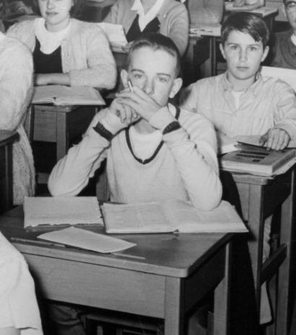
STUDENT A
STUDENT B
SELF-DIRECTED LEARNER
COMPLEX THINKER
EFFECTIVE COMMUNICATOR
COMMUNITY CONTRIBUTOR
QUALITY PRODUCER
EFFECTIVE & ETHICAL USER OF TECHNOLOGY
CREATOR AND INNOVATOR
MATH SCIENCE ENGLISH SOCIAL STUDIES

Slide 10
TOP SKILLS
2020
2015
1. COMPLEX PROBLEM SOLVING
1. COMPLEX PROBLEM SOLVING
2. CRITICAL THINKING
2. COORDINATING WITH OTHERS
3. CREATIVITY
3. PEOPLE MANAGEMENT
4. PEOPLE MANAGEMENT
4. CRITICIAL THINKING
5. COORDINATING WITH OTHERS
5. NEGOTIATION
Source: Future of Jobs Report, World Economic Forum
Notes:
This slide should be 4cs table

Slide 11
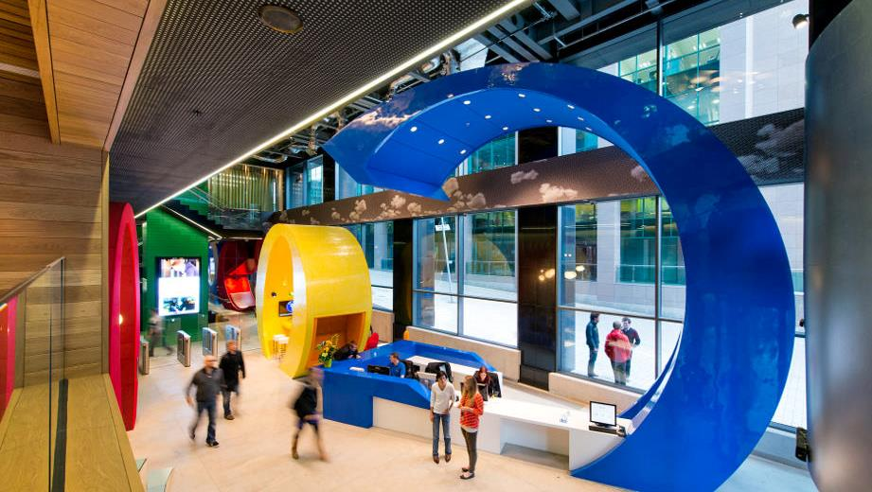
“
We’re less concerned about grades and transcripts and more interested in how you think. Show us how you would tackle the problem presented—don’t get hung up on nailing the ‘right’ answer.”
— GOOGLE
Source: www.google.com/about/careers/lifeatgoogle/hiringprocess/
Notes:
Add source and the word even

Slide 12
WHERE DO WE GO FROM HERE?
ADVICE TO OLLIE’S SUPERINTENDENT

Slide 13
5 PIECES
OF ADVICE

Slide 14
1. VISION
2. PEDAGOGY
3. ASSESSMENT
4. CULTURE
5. LEADERSHIP

Slide 15
1. VISION
2. PEDAGOGY
3. ASSESSMENT
4. CULTURE
5. LEADERSHIP

Slide 16
FOCUS ON A
PROFILE OF A GRADUATE

Slide 17
STUDENT A
STUDENT B
SELF-DIRECTED LEARNER
COMPLEX THINKER
EFFECTIVE COMMUNICATOR
COMMUNITY CONTRIBUTOR
QUALITY PRODUCER
EFFECTIVE & ETHICAL USER OF TECHNOLOGY
CREATOR AND INNOVATOR
MATH SCIENCE ENGLISH SOCIAL STUDIES

Slide 19
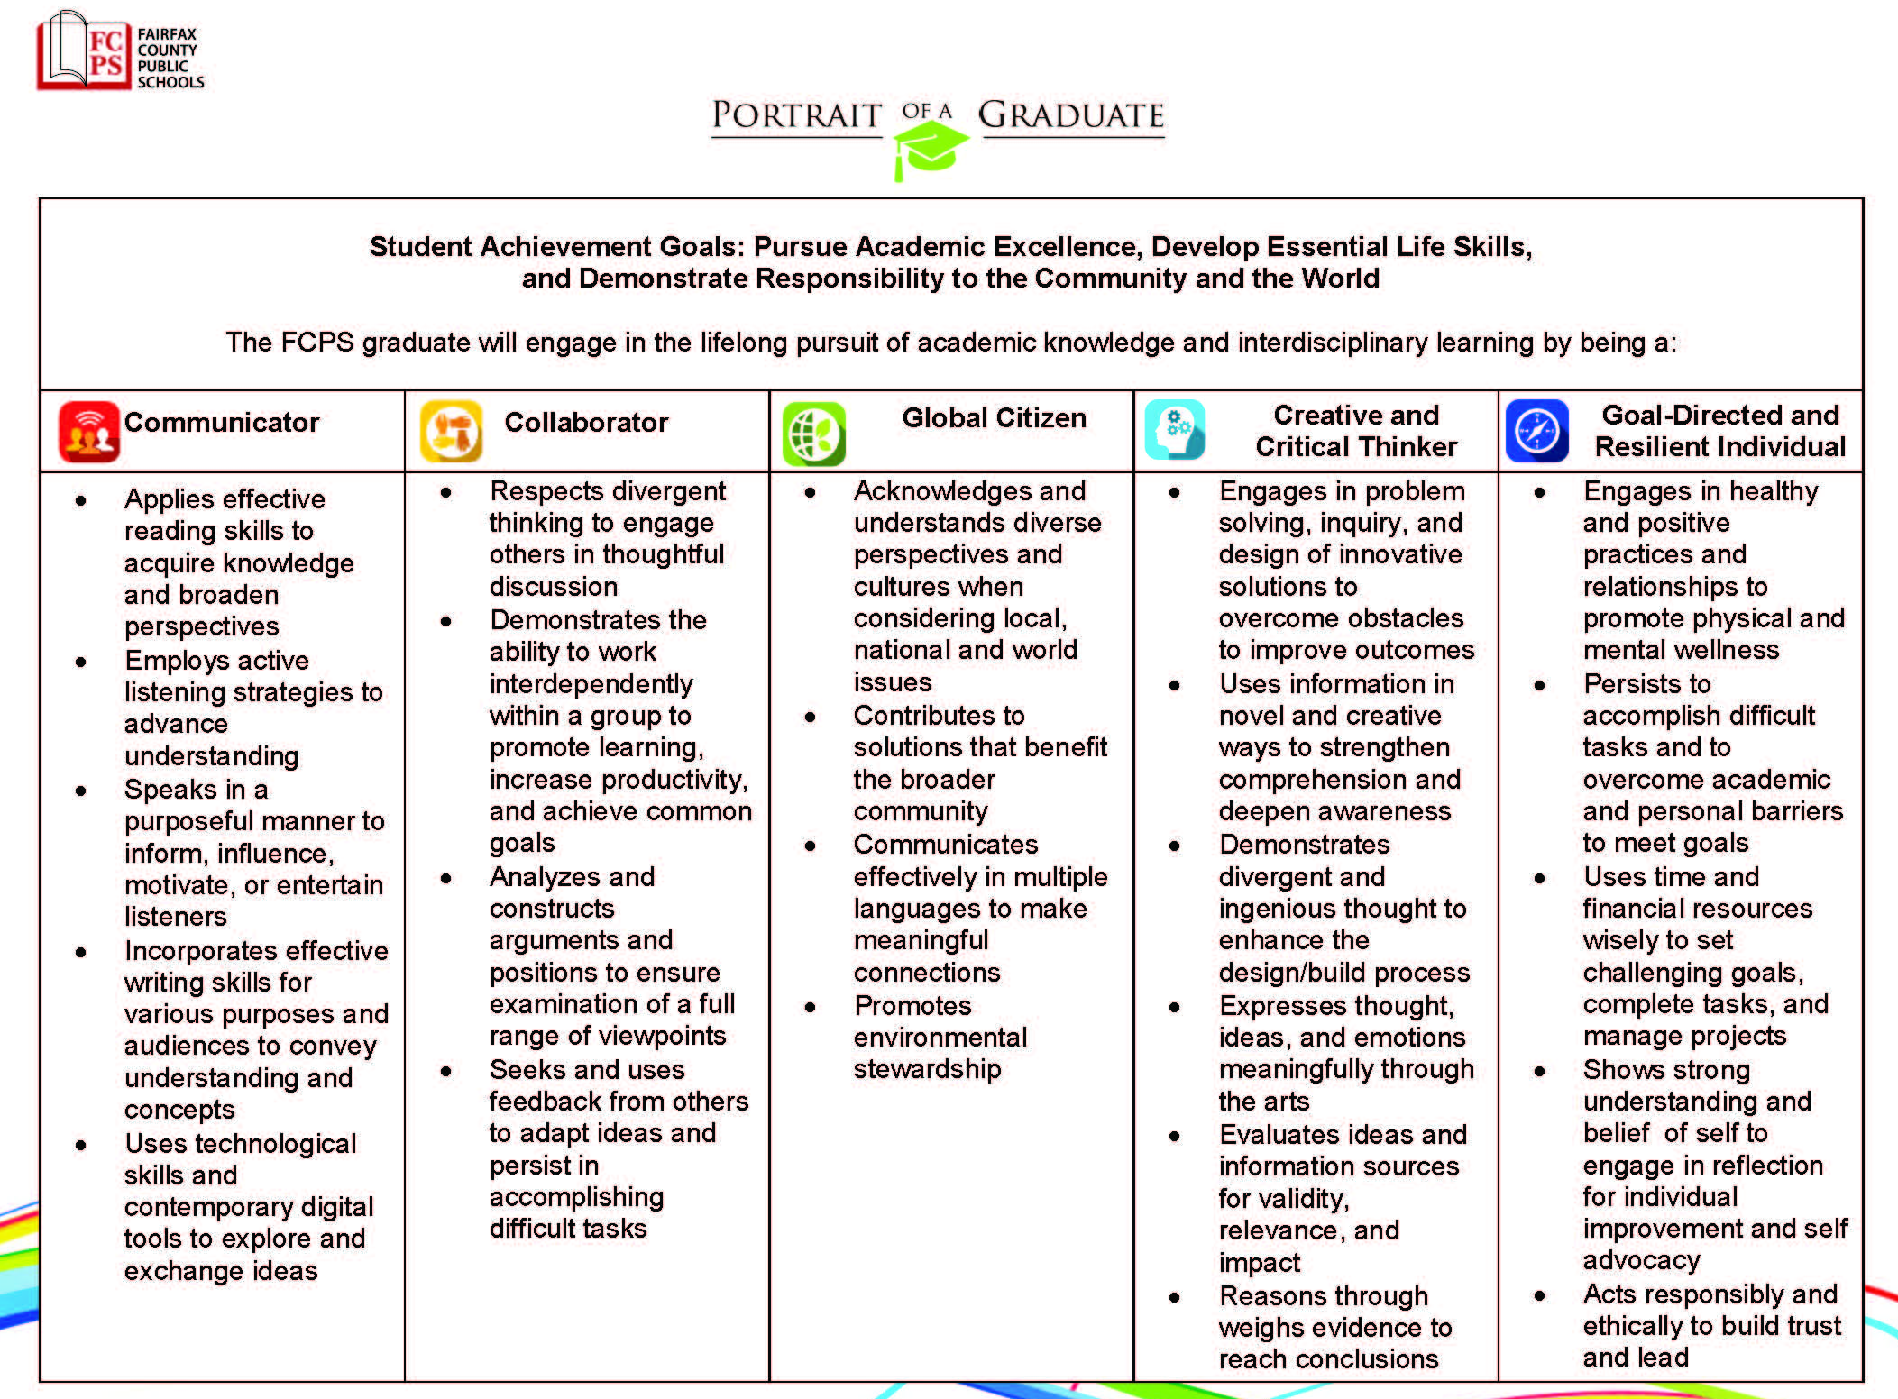

Slide 20
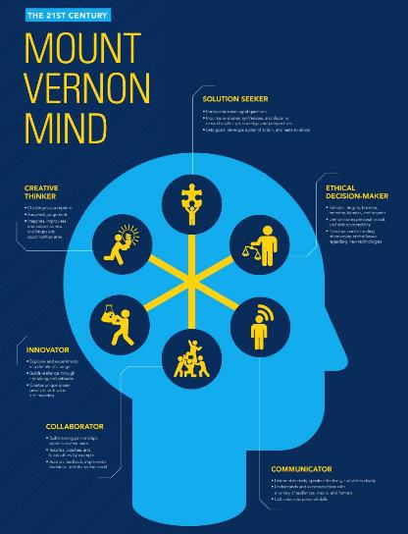

Slide 22
™

Slide 23
1. VISION
2. PEDAGOGY
3. ASSESSMENT
4. CULTURE
5. LEADERSHIP

Slide 24
VISIT 21ST CENTURY CLASSROOMS
HIGHLIGHT INNOVATIVE TEACHER PRACTICES
FOCUS ON NEW PEDAGOGIES

Slide 25
AUSTIN’S BUTTERFLY

Slide 26
AUSTIN’S BUTTERFLY

Slide 27
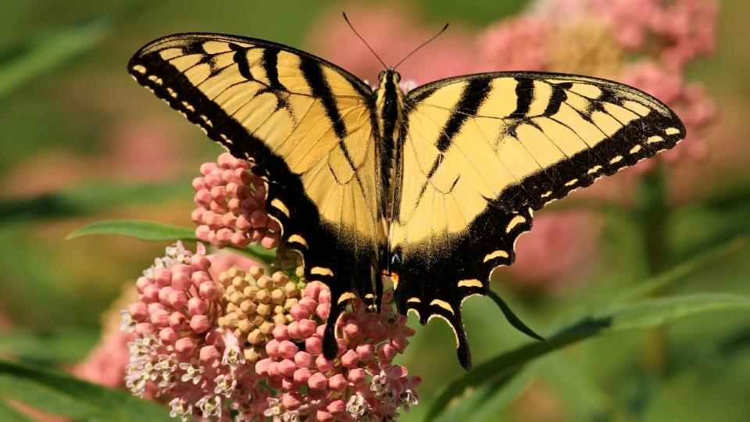
ASSIGNMENT PHOTO

Slide 28
ASSIGNMENT PHOTO
DRAFT 1
DRAFT 2
DRAFT 3
DRAFT 4
DRAFT 5
Source: Ron Berger, Expeditionary Learning

Slide 29
DRAFT 6

Slide 30
1. VISION
2. PEDAGOGY
3. ASSESSMENT
4. CULTURE
5. LEADERSHIP

Slide 31
DEFINE WHAT MATTERS MOST
PRACTICE WHAT MATTERS MOST
ASSESS WHAT MATTERS MOST

Slide 32
Notes:
ADD CRITICAL THINKING RUBRIC

Slide 33
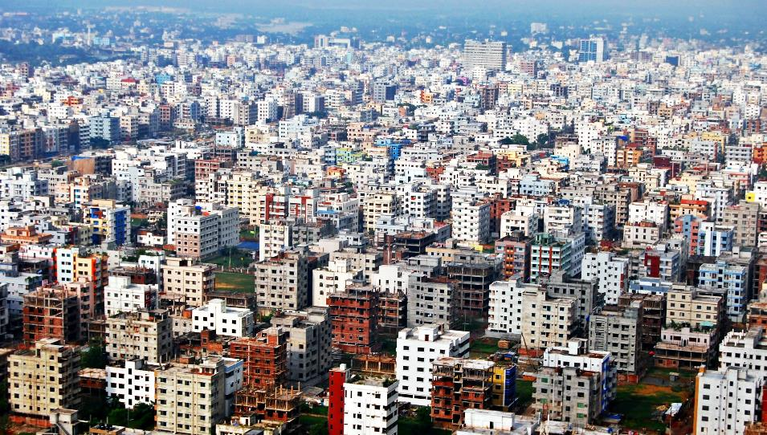
4CS PERFORMANCE ASSESSMENT

Slide 34
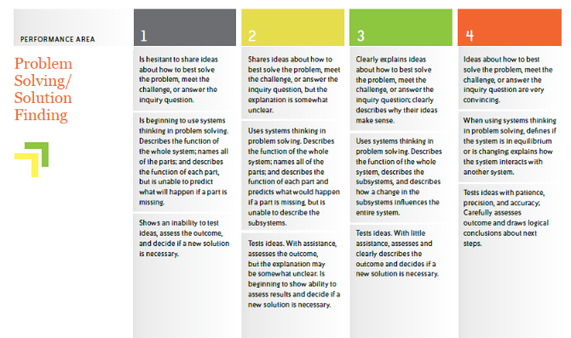
CRITICAL THINKING RUBRIC
Notes:
ADD CRITICAL THINKING RUBRIC

Slide 35
1. VISION
2. PEDAGOGY
3. ASSESSMENT
4. CULTURE
5. LEADERSHIP

Slide 36
FOCUS ON COLLABORATIVE CONTINUOUS IMPROVEMENT
CREATE SAFE SPACES FOR POWERFUL COLLABORATION

Slide 37
NORMS
Hard on the content, soft on the people
Be kind, helpful & specific
Share the air (or “step up, step back”)
Reflect on use of protocol
PROJECT TUNING PROTOCOL
Notes:
Show a picture of HTH, improvement protocol=austin’s butterfly for adults
Bulleted list of protocol steps
url for hth at the bottom

Slide 38
Culture of Accountability
Culture of Transformation

Slide 39
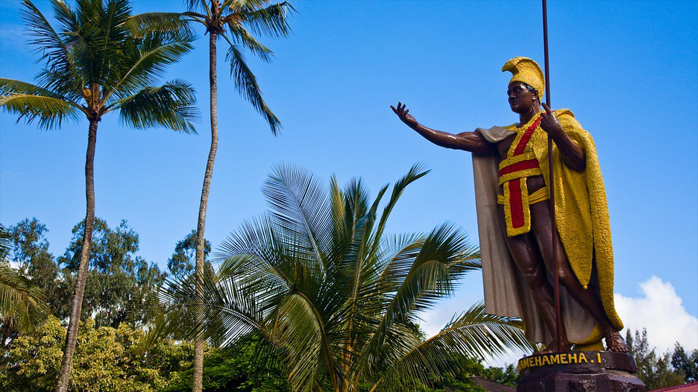
1. VISION
2. PEDAGOGY
3. ASSESSMENT
4. CULTURE
5. LEADERSHIP

Slide 40
MODEL THE 4CS CHANGE YOU WOULD LIKE TO SEE
CONTINUE TO LEAD AND LEARN IN PROFESSIONAL LEARNING COMMUNITIES

Slide 41
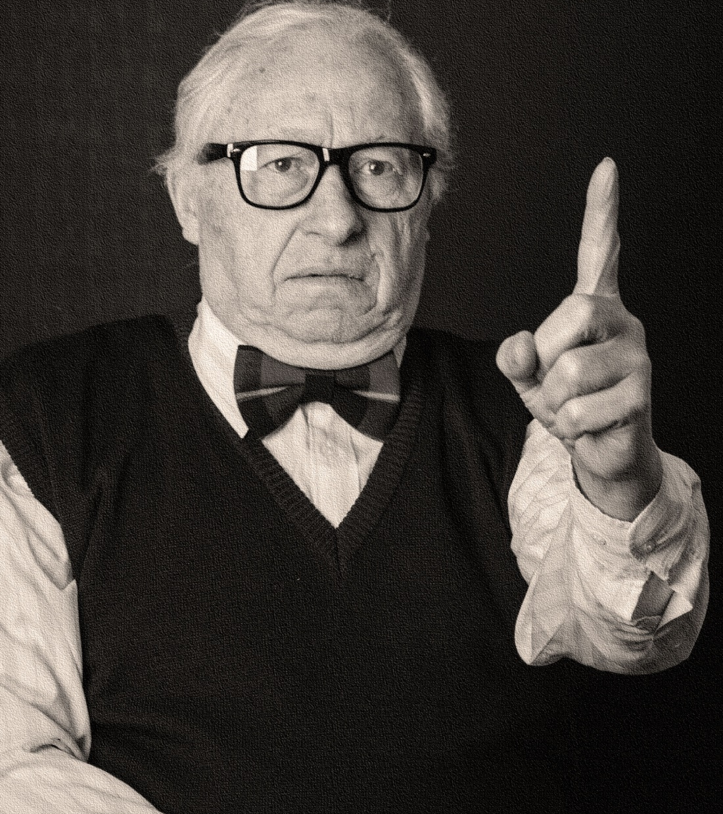
LEADER A
LEADER B
COLLABORATOR
CREATIVE & INNOVATIVE
AUTHORITATIVE
TOP DOWN STYLE
EXPERT
MANAGER
CREATIVE PROBLEM SOLVER
EFFECTIVE COMMUNICATOR
Notes:
Leader A vs Leader B
Talk about EL21 PLC

Slide 42
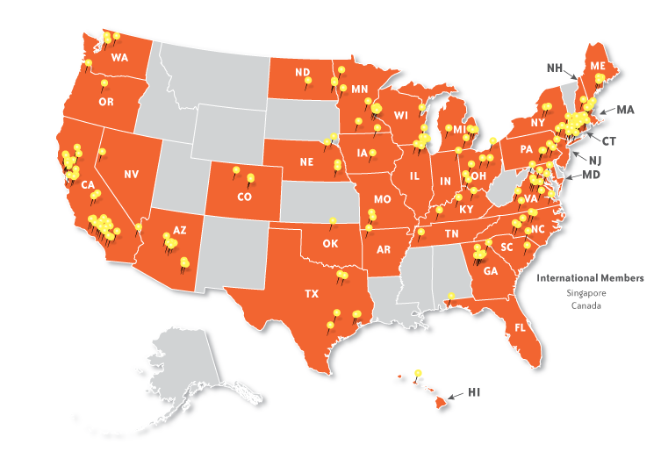
Notes:
EL21 Map

Slide 43
1. VISION
2. PEDAGOGY
3. ASSESSMENT
4. CULTURE
5. LEADERSHIP

Slide 44
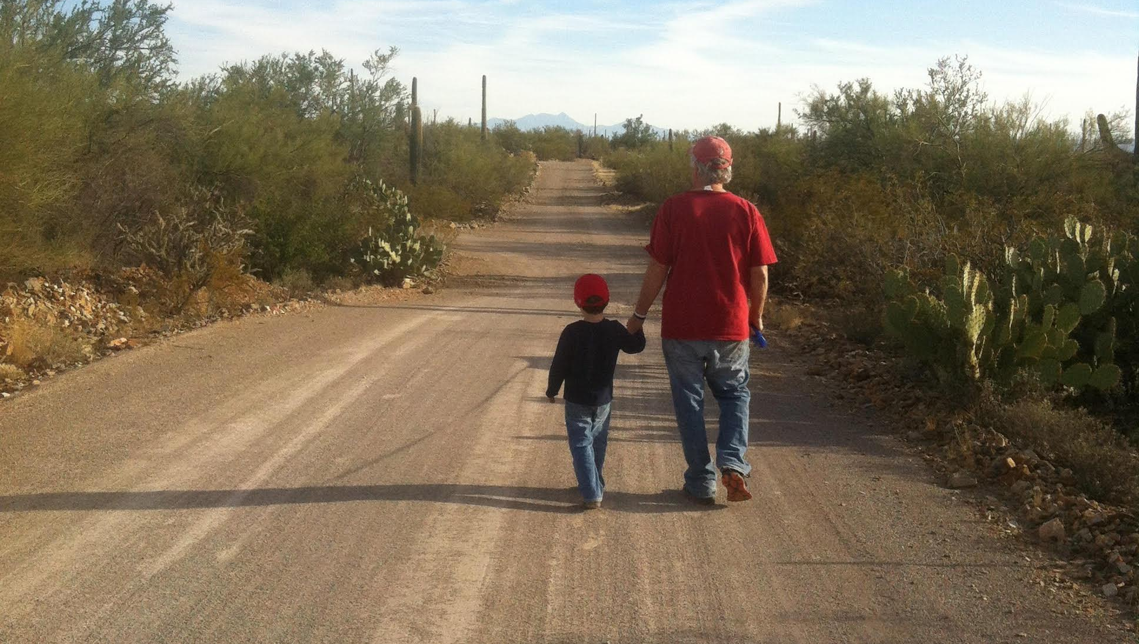
LETTERS TO OLLIE’S SUPERINTENDENT
http://goo.gl/KdCdNp

Slide 45
SELF-DIRECTED LEARNER
COMPLEX THINKER
EFFECTIVE COMMUNICATOR
COMMUNITY CONTRIBUTOR
QUALITY PRODUCER
EFFECTIVE & ETHICAL USER OF TECHNOLOGY
CREATOR AND INNOVATOR
STUDENT B

Slide 46
QUESTIONS?
@kenkay21
kkay@edleader21.com
www.edleader21.com

