Slide 1
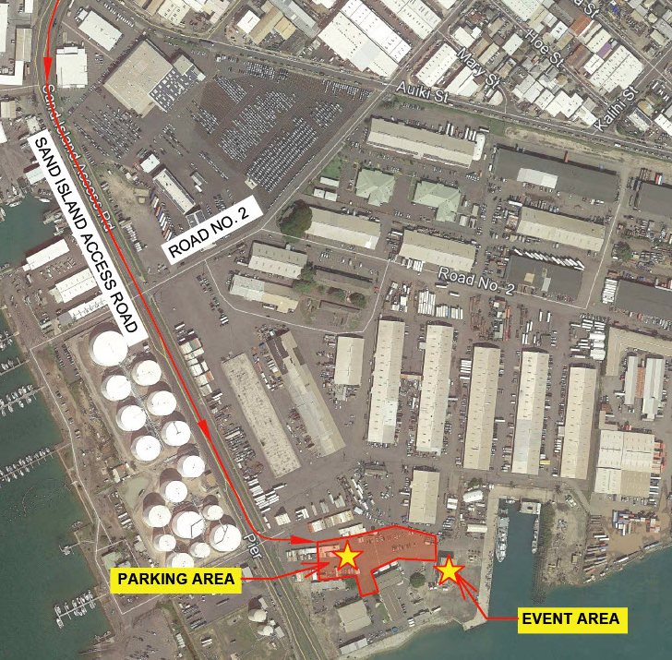
GROUNDBREAKING CEREMONY FOR THE
KAPALAMA CONTAINER TERMINAL
Directions:
(EAST BOUND)
Head east on Nimitz Hwy.
Stay in your far right lane and take a right on Sand Island Access Road
Head toward Sand Island
Take a left before the bridge at the SNUG HARBOR ENTRANCE (opposite side of Keehi Boat Harbor)
Follow signs to the event parking area
(WEST BOUND)
Head West on Nimitz Hwy.
Take a left on to Sand Island Access Road
Head toward Sand Island
Take a left before the bridge at the SNUG HARBOR ENTRANCE (opposite side of Keehi Boat Harbor)
Follow signs to the event parking area
SNUG
SNUG HARBOR ENTRANCE

